Slide 1

3D Inspection Rover
Team 8
Bi-Weekly Update 2
Sponsor:
Kevin Nowka
TA:
Eric Robles
Team Members:
Chris Dumont
Dalton Hines
Felipe Villegas
Celeste Waters
Notes:
Normal text size and our names are all size 24
Titles are all size 30 except first and last slides

Slide 2

Project Summary
The Problem Is:
Tomato identification is a time-consuming process
Time increases rapidly with greenhouse size
There needs to be a way to reduce man hours

Slide 3
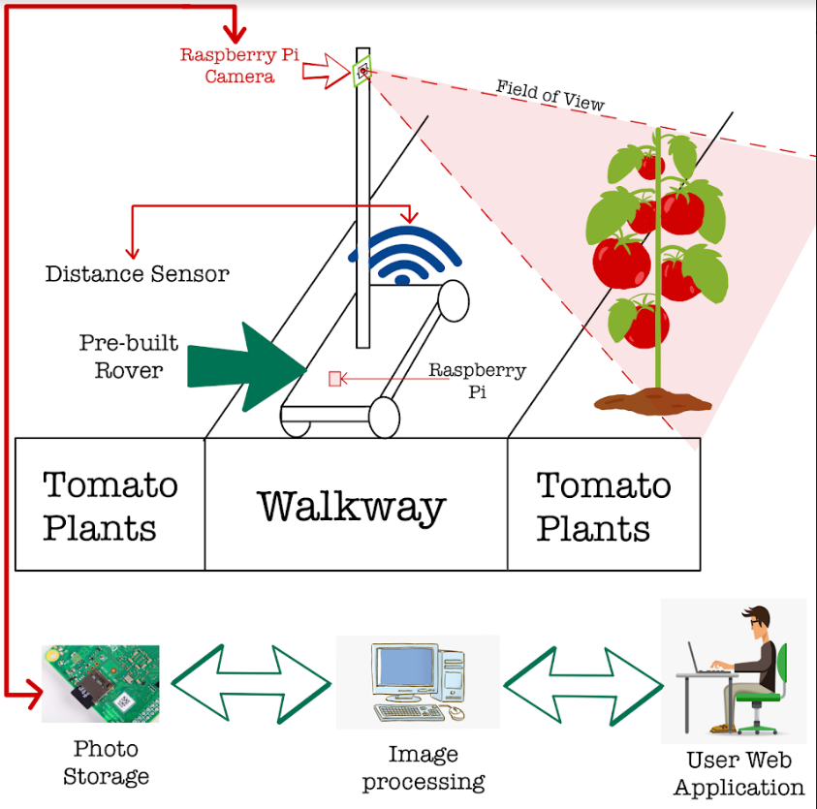
Project Summary
The Solution is:
Create a rover that will autonomously navigate a greenhouse
Categorize all tomatoes
Make the data available to the owner on a website and database

Slide 4
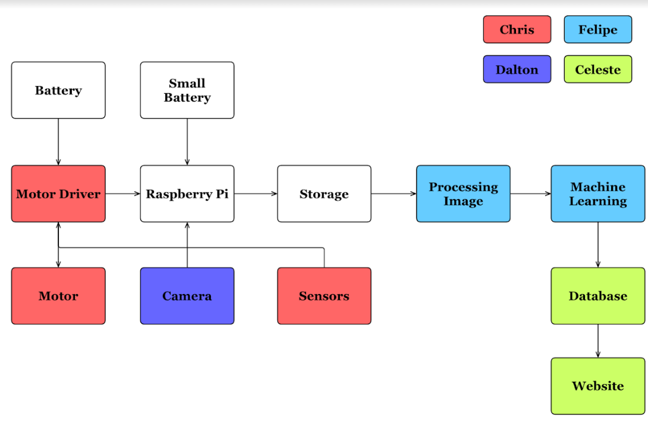
Subsystem Overview
Notes:
Navigation (Red)
Traversing the greenhouse
avoid obstacles in path
Camera Positioning (Purple)
Move Camera up/down mast
Take clear picture of all tomatoes
Image Processing (Blue)
Use machine learning to classify all tomatoes by ripeness
Database/Website (Green)
Save all images
Produce useful charts
Track growth

Slide 5
Project Changes Since Last Presentation
Rover no longer has to determine distance to next tomato plant
Expects greenhouse to be a grid

Slide 6
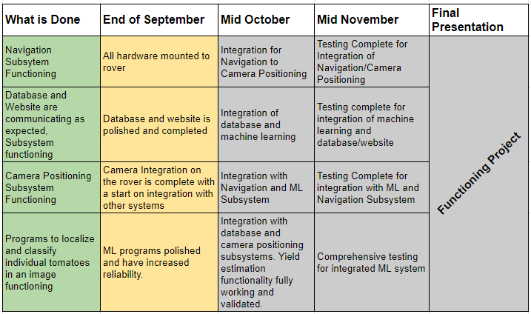
Project Timeline

Slide 7
Navigation Subsystem
Chris Dumont
Accomplishments Since Last Presentation ~15 Hours | Plans until next presentation
AutoCad drawings made for all needed 3D printed parts Complete Wiring Diagram made for integration with camera positioning subsystem (Dalton) | Have parts printed and mounted, all mechanical mounting done Circuit made in hardware Begun code integration with camera positioning subsystem

Slide 8
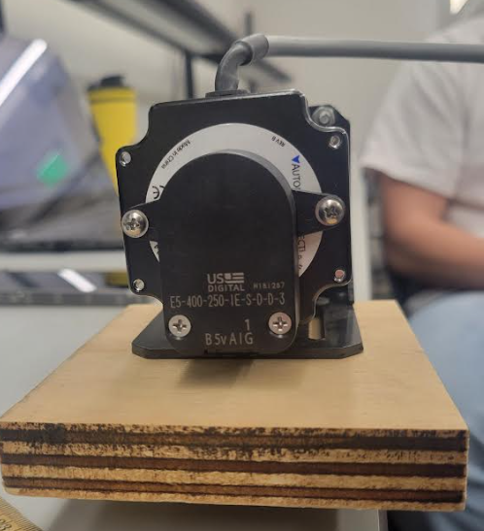
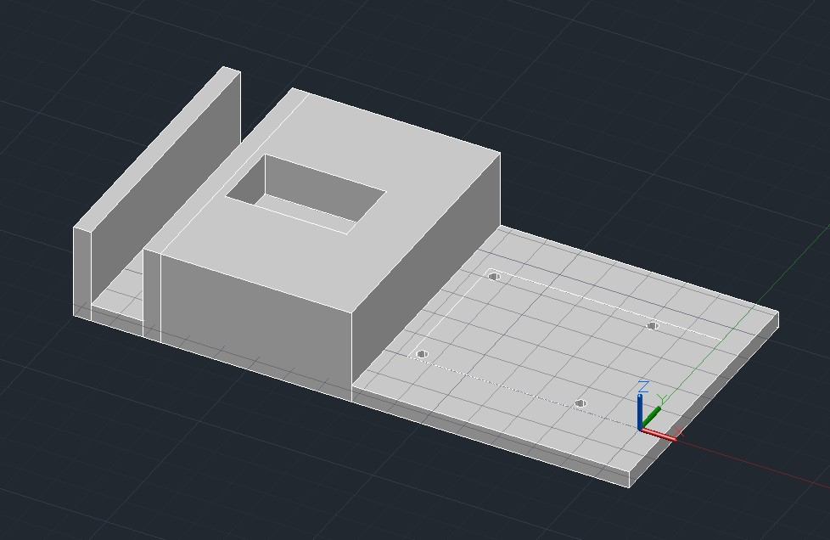
Hardware Mounting: Mast
Chris Dumont
Thick slot for wood to fit.
Rectangular cutout for motor to rest it.
Flat area with screw holes to mount Raspberry Pi.

Slide 9
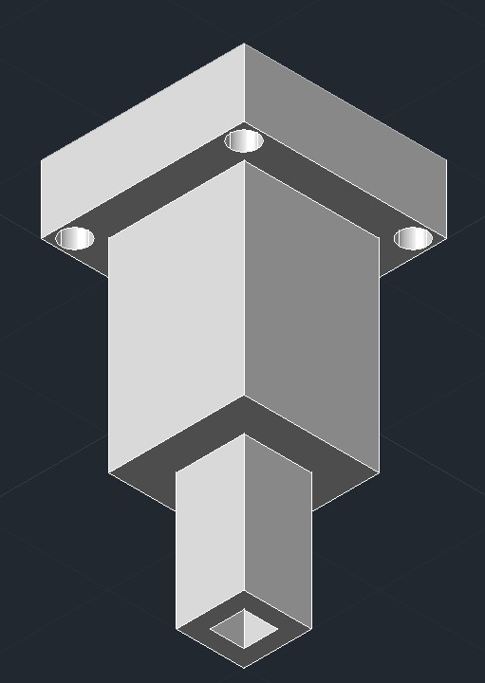
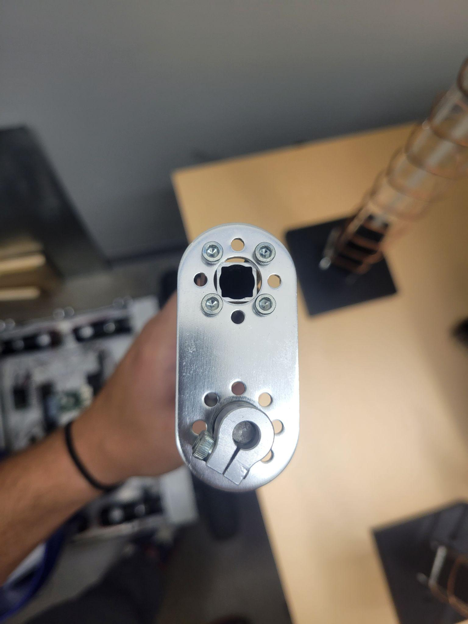
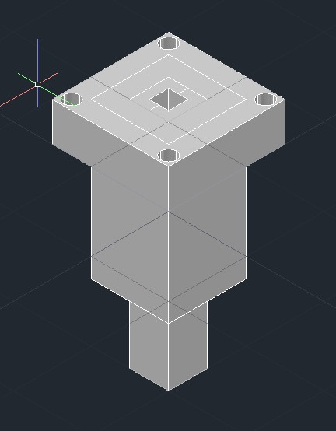
Hardware Mounting: Mast
Chris Dumont
Designed to fit into top of mast.
Inserted into not rotating part.
4 holes are for rope to run to from bottom corners of rover.

Slide 10
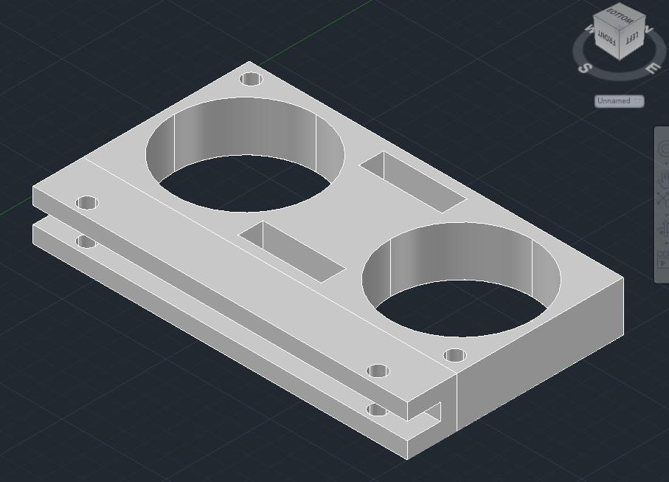
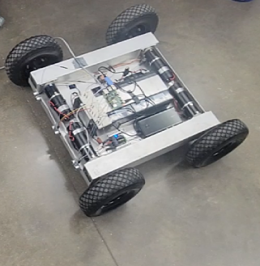
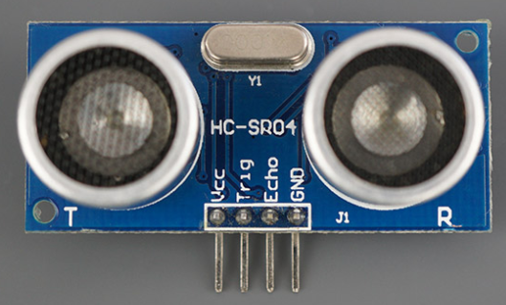
Hardware Mounting: Distance Sensor
Chris Dumont
Sensor fits upside down into mount.
Mount fits over from of rover.
Screw holes on bottom of mount to secure to rover.

Slide 11
Camera Positioning Subsystem
Dalton Hines
Accomplishments since last presentation ~ 10 Hours | Plans until next presentation
Camera operation Wiring designed for gimbal and driver | Get accustomed to new camera Proto-board design Camera mounting

Slide 12
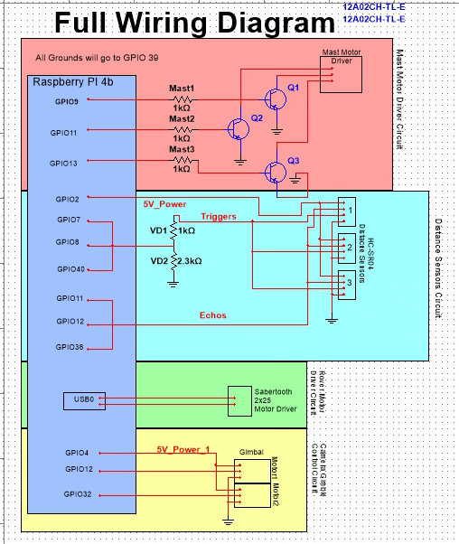
Wiring Diagram
Dalton Hines
Full wiring design for navigation and camera positioning
Includes sensors, drivers, and gimbal servos

Slide 13
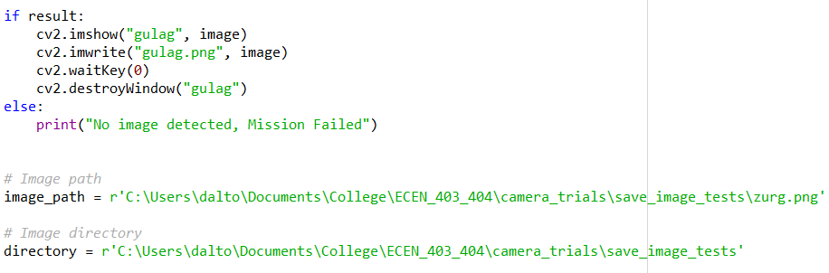
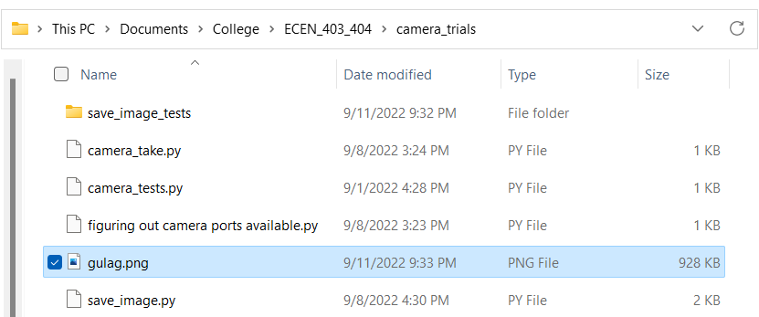
Image Saving
Successfully able to take and save image
Verification of image

Slide 14
Machine Learning Subsystem
Felipe Villegas
Accomplishments since last presentation ~ 10 Hours | Plans until next presentation
Acquired Realsense D435 stereo camera Began determining stereo camera application specifics for yield estimation | Familiarity with Realsense D435 Programming and Use Preliminary volume yield estimation code Preliminary ML preparations for camera system integration

Slide 15
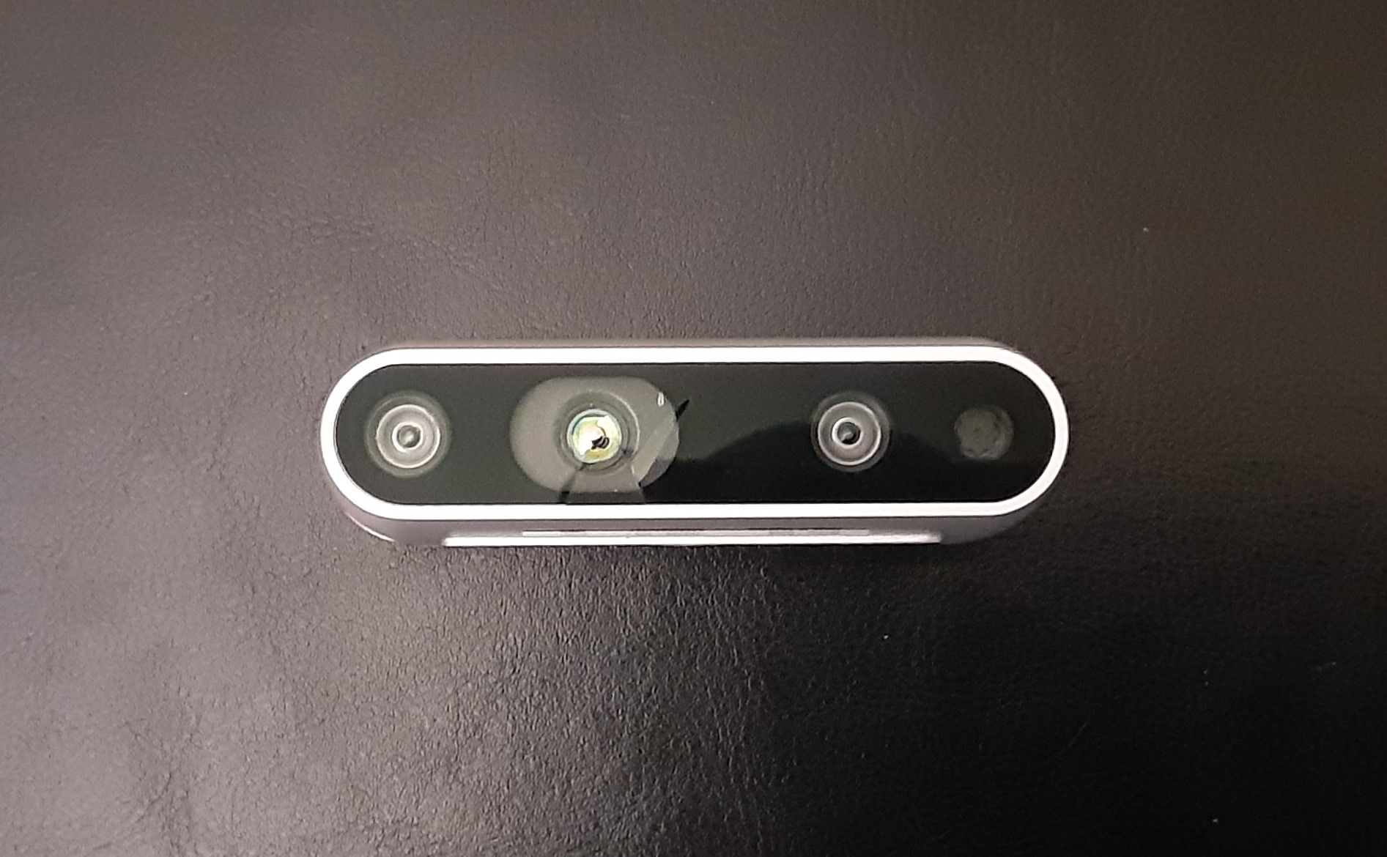
Machine Learning Subsystem
Felipe Villegas
Intel’s RealSense D435 Camera
Features:
Wide field of view
Works well in low-light environments
Self calibration

Slide 16
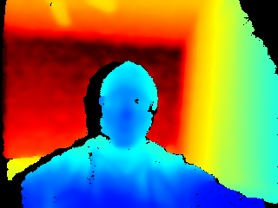

Machine Learning Subsystem
Felipe Villegas
Camera Appears to work well
Can determine length to object for several meters

Slide 17
Database/Website Subsystem
Celeste Waters
Accomplishments since last presentation ~13 hrs | Plans until next presentation
Database was changed to aws Created a new react webapp Resecured a connected with the aws database Client interaction with webapp | Components to display data from database Preparation to connect with ML

Slide 18
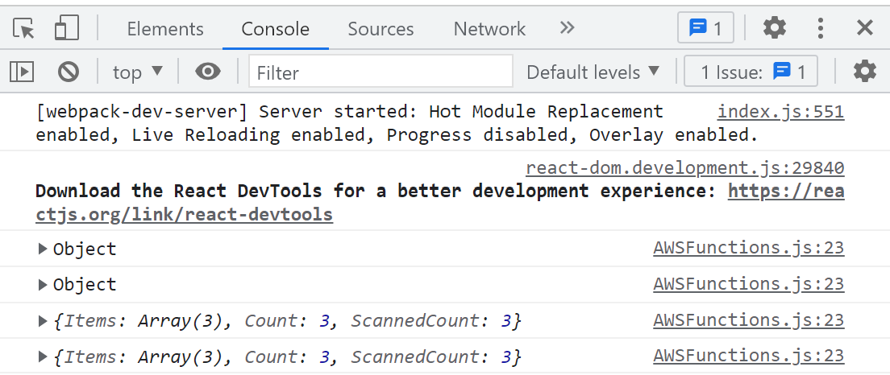
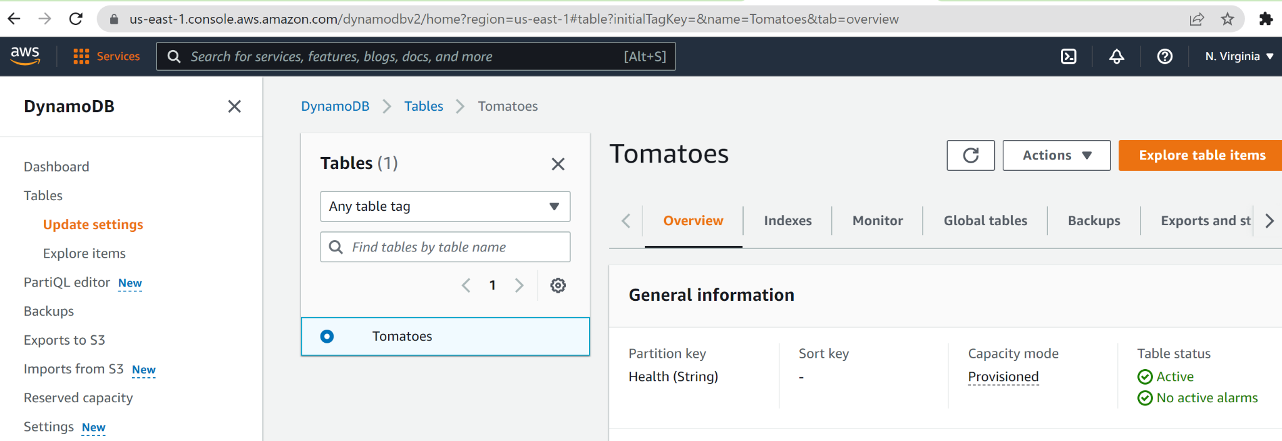
Database/Website Subsystem
Celeste Waters
What Works
New react webapp
React Database effectively replaced firestore
Communication between website and database was reestablished
What doesn’t
No integration to other subsystem
Components to display data from database

Slide 19
Parts Ordering Status
Part | Description | Order Placed | Arrived
403 Parts | All Parts needed for 403 | Yes | Yes
C-clamps | Clamp used to secure mast to rover | Available in WEB lab | Yes
Wire | Used to prevent swaying of mast | Available in FEDC | Yes

Slide 20
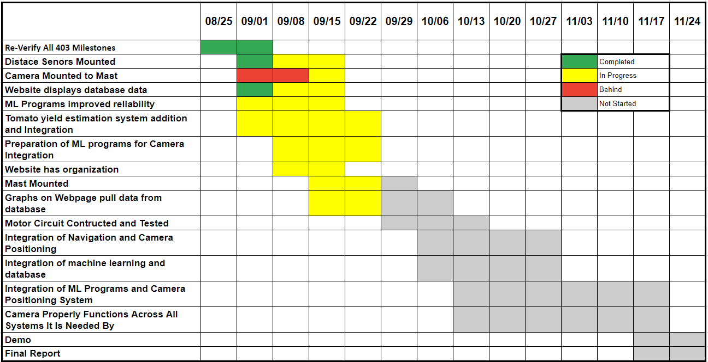
Execution Plan

Slide 21
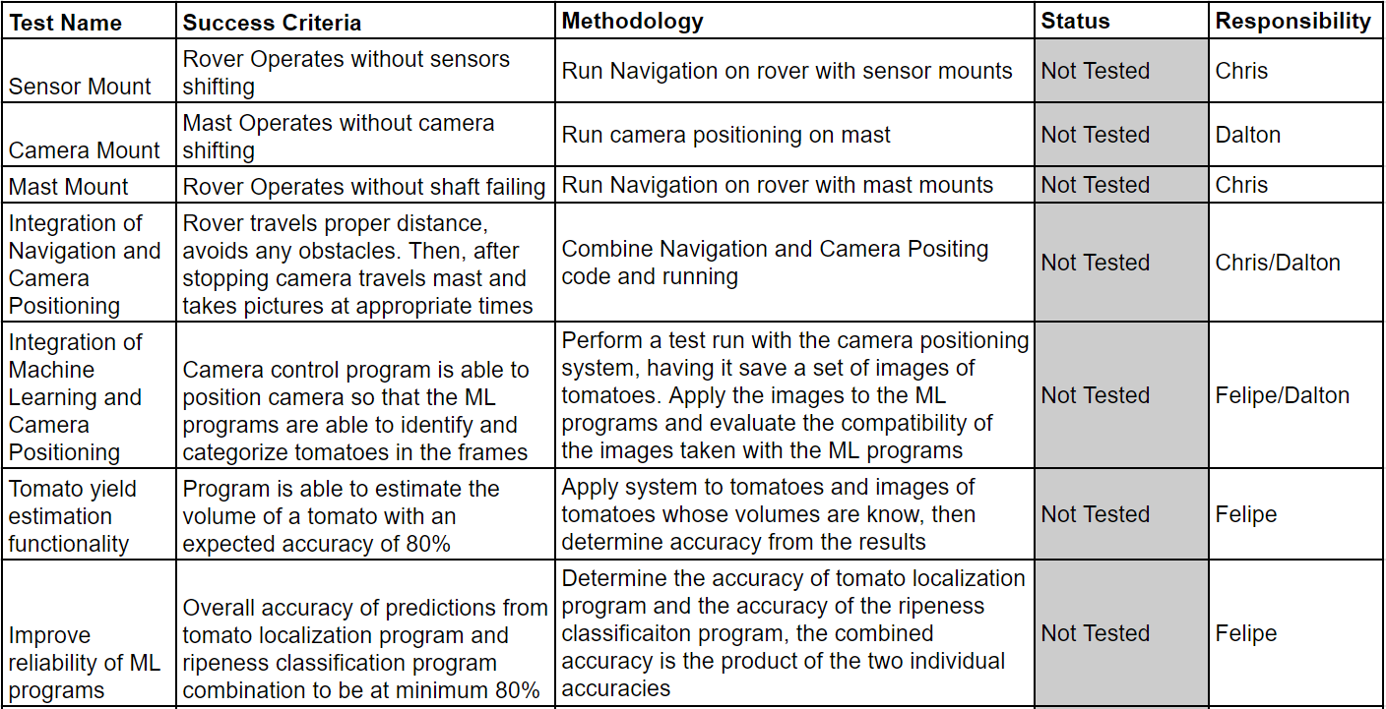
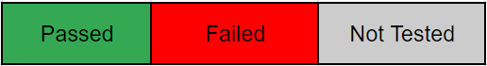
Validation Plan

Slide 22
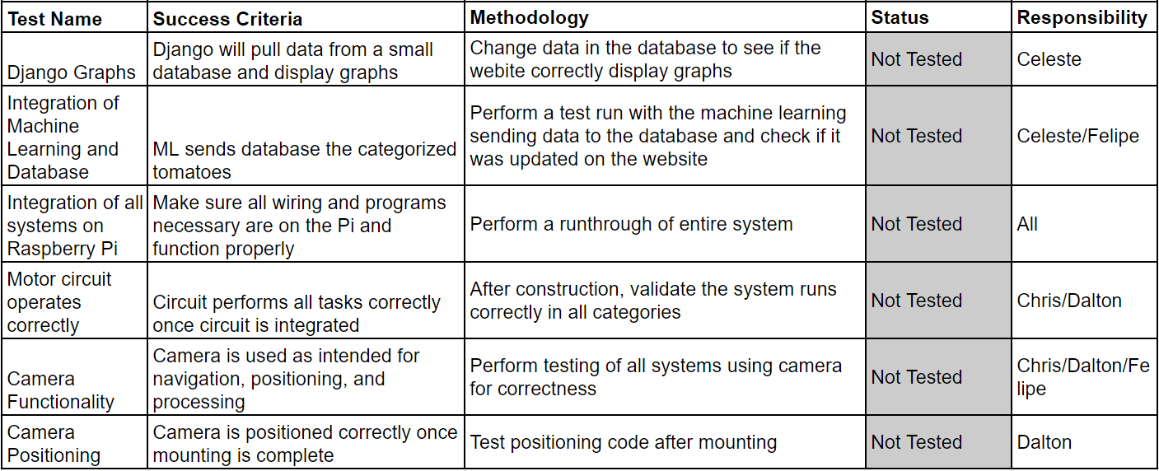
Validation Plan

Slide 23
QUESTIONS

